Slide 1
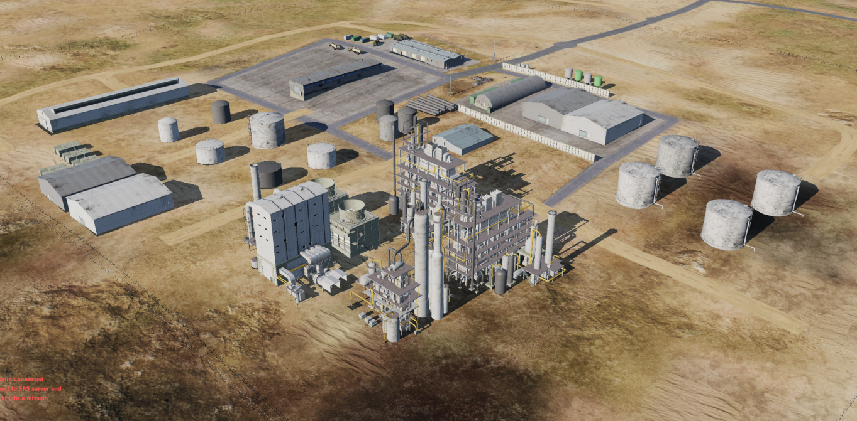
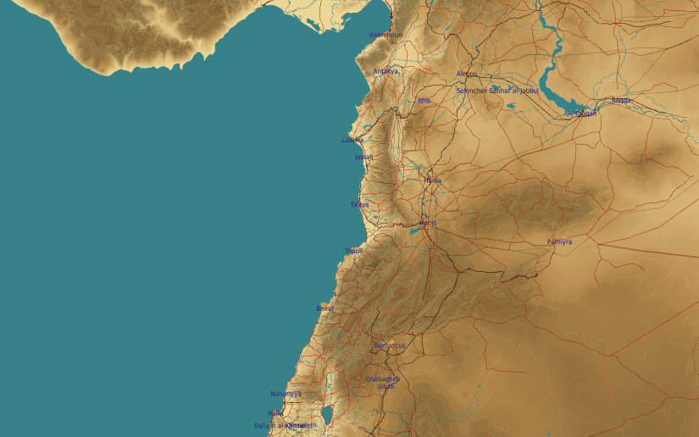
OPARTGT060 Chemical Weapons Production Facility
Hardened Storage Facility
N
5
60
6-7
DESCRIPTION OF THE DESIRED POINTS OF IMPACT WITH WPN TYPE:
OPARTGT060A – Weapon Production Hall
DPI 1 N35 34.102 E 038 25.828/1191ft/(2000 Ibs bomb)
DPI 2 N35 34.084 E 038 25.818/1178ft/(2000 Ibs bomb)
DPI 3 N35 34.088 E038 25.789/1184ft/(2000 lbs bomb)
DPI 4 N35 34.110 E038 25.787/1194ft/(2000 lbs bomb)
OPARTGT060B – Hardened Storage
DPI 5 N35 34.098 E 038 25.899/1207ft/(1000 Ibs bomb)
DPI 6 N35 34.153 E 038 25.779/1198ft/(1000 Ibs bomb)
DPI 7 N35 34.169 E 038 25.782/1191ft/(1000lbs bomb)
1-4
Weapon Production
OPARTGT060A – 3 to 5 storey buildings made of concrete slab supported by reinforced concrete base and pillars, flat poured roof, requires delayed fuzing.
Suggested fuzing solution on DPIs 1-4 – contact to open up the roof followed by delayed to pierce through floors and affect building structure.
OPARTGT060B – Walls made of slabs, poured roof supported by metal frame and reinforced concrete pillars. Requires delayed fuzing.
4
5
6
7
8

